Slide 1
Security Overview in Hazelcast Enterprise
Josef Cacek
2022
Notes:
Welcome to a presentation about security features in Hazelcast Enterprise. My name is Josef Cacek and I’m a security architect in Hazelcast.

Slide 2
Agenda
Summary first
Confidentiality
Authentication
Authorization
Other topics
Notes:
What will we talk about today? Here are the topics. We’ll start with a summary and continue with the most interesting security topics - encryption of data, authentication on network connections, and access control.
We’ll finish by listing some other security features.

Slide 3
Setting a baseline
Hazelcast supports several protocols
  member(-to-member)
  client(-to-member)
  HTTP/REST
  memcache
different levels of security are available for different protocols
  confidentiality (TLS): all protocols
  authentication: member, client, partly REST
  authorization: client
Notes:
Before we start with the described topics, let’s set a baseline describing some basic facts…
client and member protocols are enabled by default;
REST is enabled in some of packagings (distributions);
memcache protocol is disabled by default

Slide 4

Setting a baseline
Default network
Advanced network
192.168.1.1:5701 client
192.168.1.1:5701
all protocols
10.0.0.1:9001 member
0.0.0.0:8080 REST

Slide 5
Summary first

Slide 6

Hazelcast Security Summary
Where to start
Configuration areas
Review security recommendations
-Dhazelcast.security.recommendations
Check sample hardened configuration
hazelcast-security-hardened.yaml (.xml)
Try for yourself security-related code samples;
Ask for Trial license if you don’t have one.
Security-related (Enterprise)
  Security
  Networking
  Persistence
  Auditlog
Cluster safety (Community)
  Advanced networking
  Jet (& SQL)
  REST endpoint groups
  Management Center scripting
  User-code deployments

Slide 7

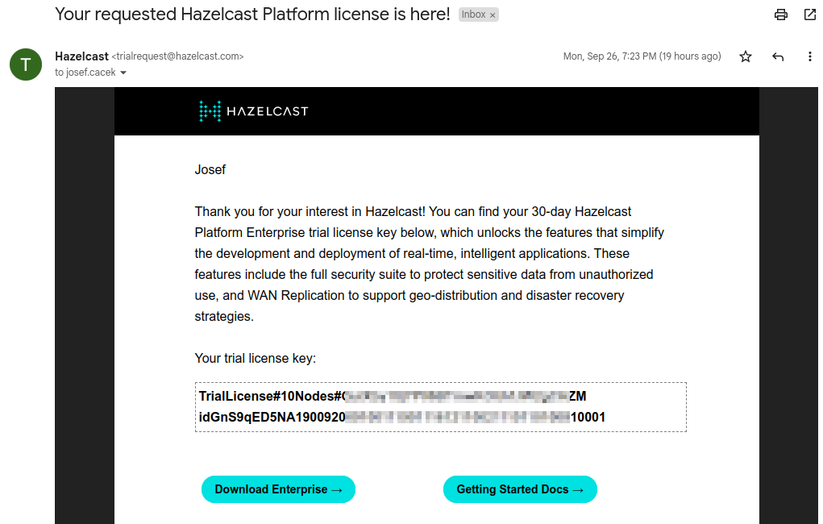
Trial license

Slide 8
DEMO
Security recommendations
and the security-hardened config
Notes:
Having all ticks green doesn’t necessarily mean You have your cluster secured. It just means you configured important security(safety)-related areas.
# start Hazelcast and show info message about security recommendations
docker run -it --rm hazelcast/hazelcast:5.1.3-slim
# start Hazelcast with security recommendations enabled
docker run -it --rm -e JAVA_OPTS=-Dhazelcast.security.recommendations hazelcast/hazelcast:5.1.3-slim

Slide 9
Confidentiality
Notes:
Confidentiality & Integrity

Slide 10
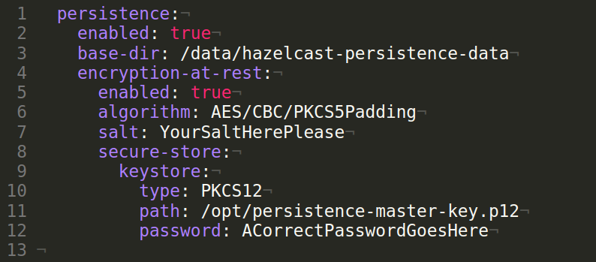
Confidentiality - Encryption
Data in transit
Data at rest
TLS / SSL
  encrypts network communications
  public-key cryptography
    certificates signed by a trusted CA
  in default configuration server doesn’t verify clients identity
Persistence encryption
  two-levels of encryption keys
    master key provided externally
    auto-generated store keys
Symmetric-Encryption
  DEPRECATED
  member-protocol only
Notes:
Hazelcast Persistence is an Enterprise feature. It allows to recover data by persisting data to disk:
map entries
JCache data
and streaming job snapshots
The persistence feature can be used to recover from:
a planned shutdown (including rolling upgrades)
a sudden cluster-wide crash,
or a single member failure.
Data in the persistence storage can be encrypted by a symmetric encryption.
Master key is stored usually in some external store - Java keystore types and Hashicorp Vault are supported.
https://docs.hazelcast.com/hazelcast/5.1/storage/configuring-persistence#how-encryption-at-rest-works
Data in the persistence store is encrypted using symmetric encryption. The encryption scheme uses two levels of encryption keys: auto-generated persistence store encryption keys (one for each configured parallelism) that are used to encrypt the chunk files and a master encryption key that is used to encrypt the store-specific encryption keys. The master encryption key is sourced from an external system called the secure store and, in contrast to the persistence-store encryption keys, it is not persisted anywhere within the persistence store.
When encryption at rest is first enabled on a member, the member contacts the secure store during startup and retrieves the master encryption key. Then, the member generates the persistence-store encryption keys, encrypts them with the master key, and stores them in the persistence store’s directory. The subsequent writes to any chunk files will be encrypted using this persistence-store encryption key. During Persistence, the member gets the master encryption key from the secure store, decrypts the persistence-store encryption keys and uses those to decrypt the chunk files.

Slide 11
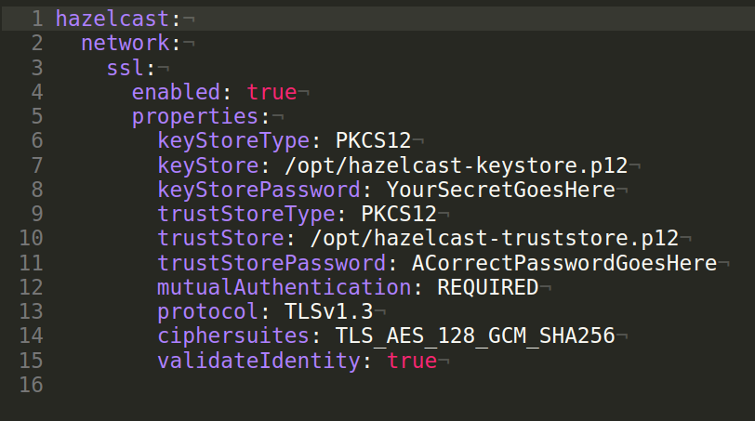
Confidentiality - TLS recommendations
Explicitly configure TLS protocol version TLSv1.3
Use the mutual authentication
Enable hostname/IP verification
Use up-to-date Java version
Keep in mind that one member is on the TLS client side in a protected member-to-member communication.
Notes:
Performance improvements in newer Java version
Security patches applied in updates.
hazelcast:
network:
# TLS configuration
ssl:
enabled: true
properties:
keyStoreType: PKCS12
keyStore: /opt/hazelcast-keystore.p12
keyStorePassword: YourSecretGoesHere
trustStoreType: PKCS12
trustStore: /opt/hazelcast-truststore.p12
trustStorePassword: ACorrectPasswordGoesHere
mutualAuthentication: REQUIRED
protocol: TLSv1.3
ciphersuites: TLS_AES_128_GCM_SHA256
validateIdentity: true

Slide 12
Authentication and Identity

Slide 13
Identity
Who am I?
how members and clients prove themselves
  username and password
  kerberos ticket
  token

Slide 14
Authentication
How to check who the others are?
verification of identities on incoming connection (i.e. on the member-side)
also assigns roles (used during authorization)
out-of-the-box provided mechanisms
  simple
  ldap
  kerberos
  tls

Slide 15
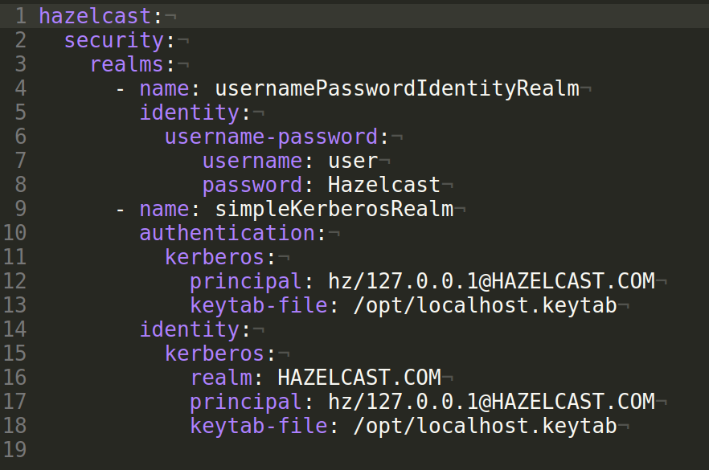
Step aside - Security realms
Security realm = named security configuration
can be referenced from other places in the configuration
available on members
limited support on Java clients too
  to allow proper Kerberos identity configuration
Notes:
hazelcast:
security:
enabled: true
realms:
- name: usernamePasswordIdentityRealm
identity:
username-password:
username: user
password: Hazelcast
- name: tokenIdentityRealm
identity:
token:
encoding: base64
value: SGF6ZWxjYXN0
- name: tlsRealm
authentication:
tls:
roleAttribute: cn
- name: simpleKerberosRealm
authentication:
kerberos:
principal: hz/127.0.0.1@HAZELCAST.COM
keytab-file: /opt/localhost.keytab
identity:
kerberos:
realm: HAZELCAST.COM
principal: hz/127.0.0.1@HAZELCAST.COM
keytab-file: /opt/localhost.keytab

Slide 16
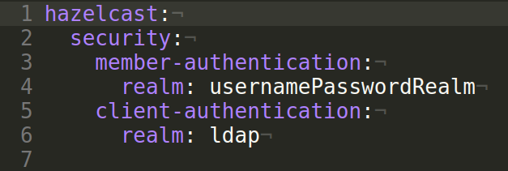
Authentication again
How to check who the others are?
client and member protocols may have different authentication configured
  i.e. reference different security realms
some REST endpoints require authentication
  the security realm for member protocol authentication is used
Notes:
hazelcast:
security:
member-authentication:
realm: usernamePasswordRealm
client-authentication:
realm: ldap

Slide 17

Default authentication
… just to keep it “easy”
when no explicit authentication configuration is provided
  either the security realm is not set
  or it doesn’t contain the authentication part
behavior depends on member’s security realm identity configuration
  username-password identity configured
    incoming connection has to provide the same username-password
  other cases
    only the cluster name is compared
Notes:
For historical and backward compatibility reasons.
When the security is disabled, just the cluster names are compared.

Slide 18
Authorization

Slide 19
Authorization on Client protocol
What is the authenticated client allowed to do?
Role-Based access control (RBAC)
  optional checking of the operation source address
protects:
  actions on data structures and Jet jobs
  management operations
  mappings, views and indexes in SQL queries
  access to resources over Jet connectors (e.g. file or JDBC)

Slide 20
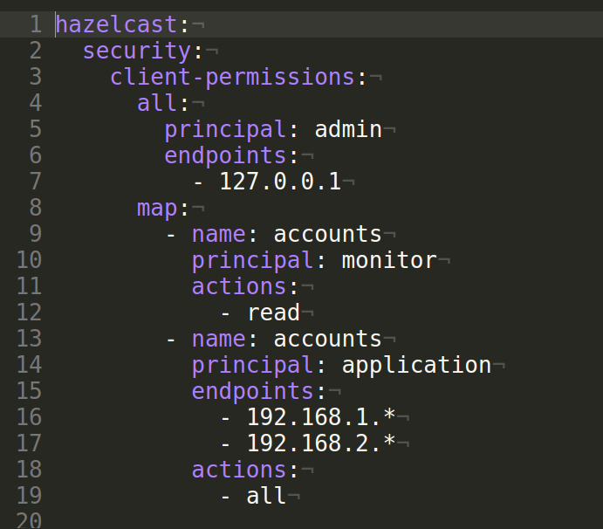
Granting permissions
What is the authenticated client allowed to do?
permissions granted to principals have:
  type
  name
  actions
    set of available actions depends on the permission type
  allowed endpoints (source addresses)
wildcards can be used in names and endpoints
root-level permission: all-permission

Slide 21
DEMO
Simple authentication
Notes:
# https://github.com/hazelcast/hazelcast-code-samples/tree/v5.1.3/enterprise/simple-authentication
<map-permission principal="monitor" name="timestamps">
<actions>
<action>read</action>
</actions>
</map-permission>

Slide 22
Other topics

Slide 23
Other security-related features
Auditlog
Validating Secrets Strength
allows observing some important events, E.g.
  network connections lifecycle
  authentications on protocols
  cluster lifecycle
default implementation uses Hazelcast logging category hazelcast.auditlog
validate passwords against a policy
  minimal secret length
  large keyspace
  no dictionary words
prints warning banner during member startup
may be enforced (i.e. prevents the start)
Notes:
Not all the passwords are validated.

Slide 24
Security debugging
great in cases when investigating security configuration issues
use
  detailed logging for category com.hazelcast.security
  Java security logging properties
  -Djava.security.debug=all \
  -Djava.net.debug=all \
  -Dsun.security.krb5.debug=true \
  -Dsun.security.jgss.debug=true
$ cat logging.properties
handlers=java.util.logging.ConsoleHandler
.level=INFO
java.util.logging.ConsoleHandler.level=ALL
com.hazelcast.security.level=ALL

Slide 25
Extensible security
JAAS authentication
  login modules (authentication)
  credential factories (identity)
custom implementation for
  AuditLog
  SecretStrengthPolicy
  SSLContextFactory
  IPermissionPolicy
finer grained control
  authorization: SecurityInterceptor
  connection establishment: SocketInterceptor

Slide 26
Summary again

Slide 27
Hazelcast Security Summary
Where to start
Review security recommendations
-Dhazelcast.security.recommendations
Check sample hardened configuration
hazelcast-security-hardened.yaml (.xml)
Try for yourself security-related code samples

Slide 28
Notes:
Thank you for your attention.
Stay safe with your Hazelcast clusters secured.

